Slide 1
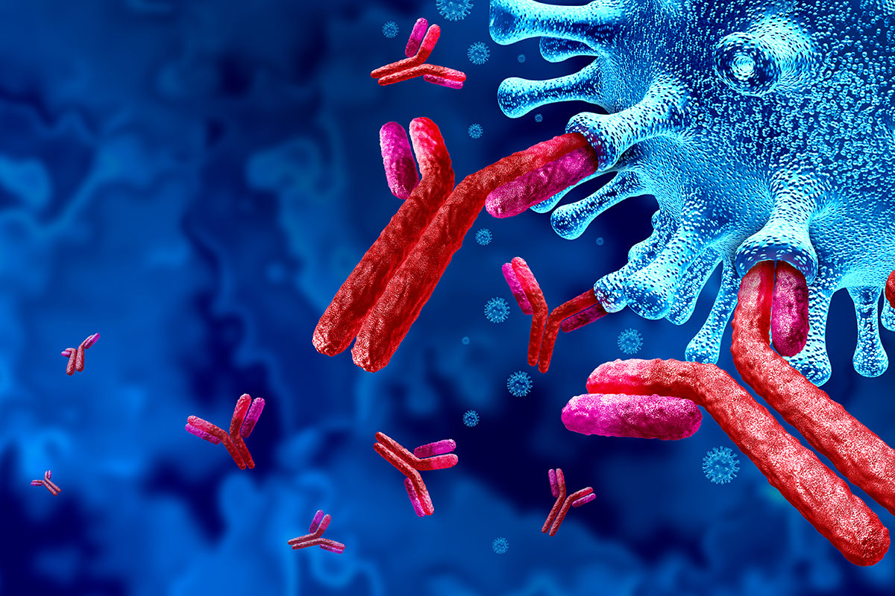
Microscale Modelling of Antibody Dependent Cellular Cytotoxicity
Luke Heirene
Helen Byrne
Eamonn Gaffney
James Yates

Slide 2
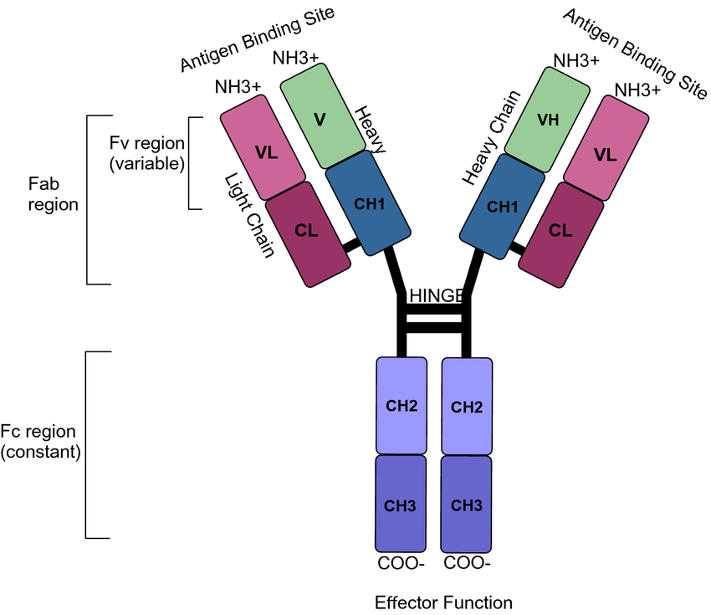
Mark JKK, Lim CSY, Nordin F, Tye GJ. Expression of mammalian proteins for diagnostics and therapeutics: a review. Mol Biol Rep. 2022 Nov;49(11):10593-10608. doi: 10.1007/s11033-022-07651-3. Epub 2022 Jun 8. PMID: 35674877; PMCID: PMC9175168.

Slide 3
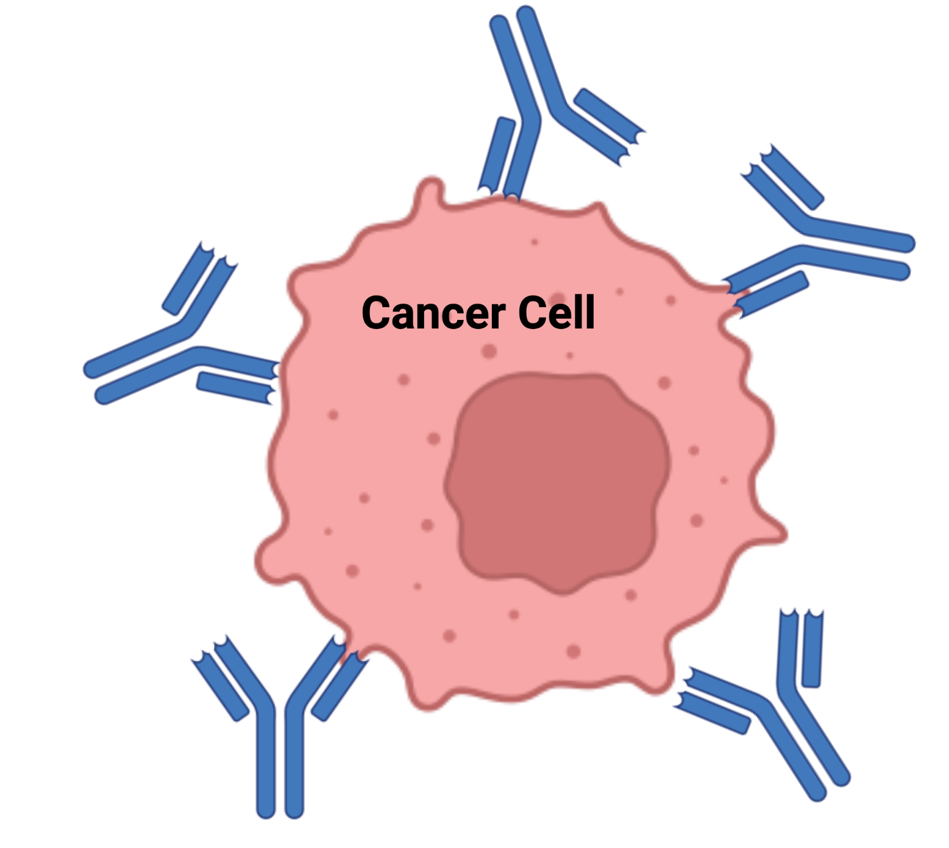
Why Monoclonal Antibodies (mabs)?
Diseases
Cancer
Alzheimer’s disease
Autoimmune diseases
Varieties
Standard mab therapy
Radioimmunotherapy
ADCs
Checkpoint therapy

Slide 4
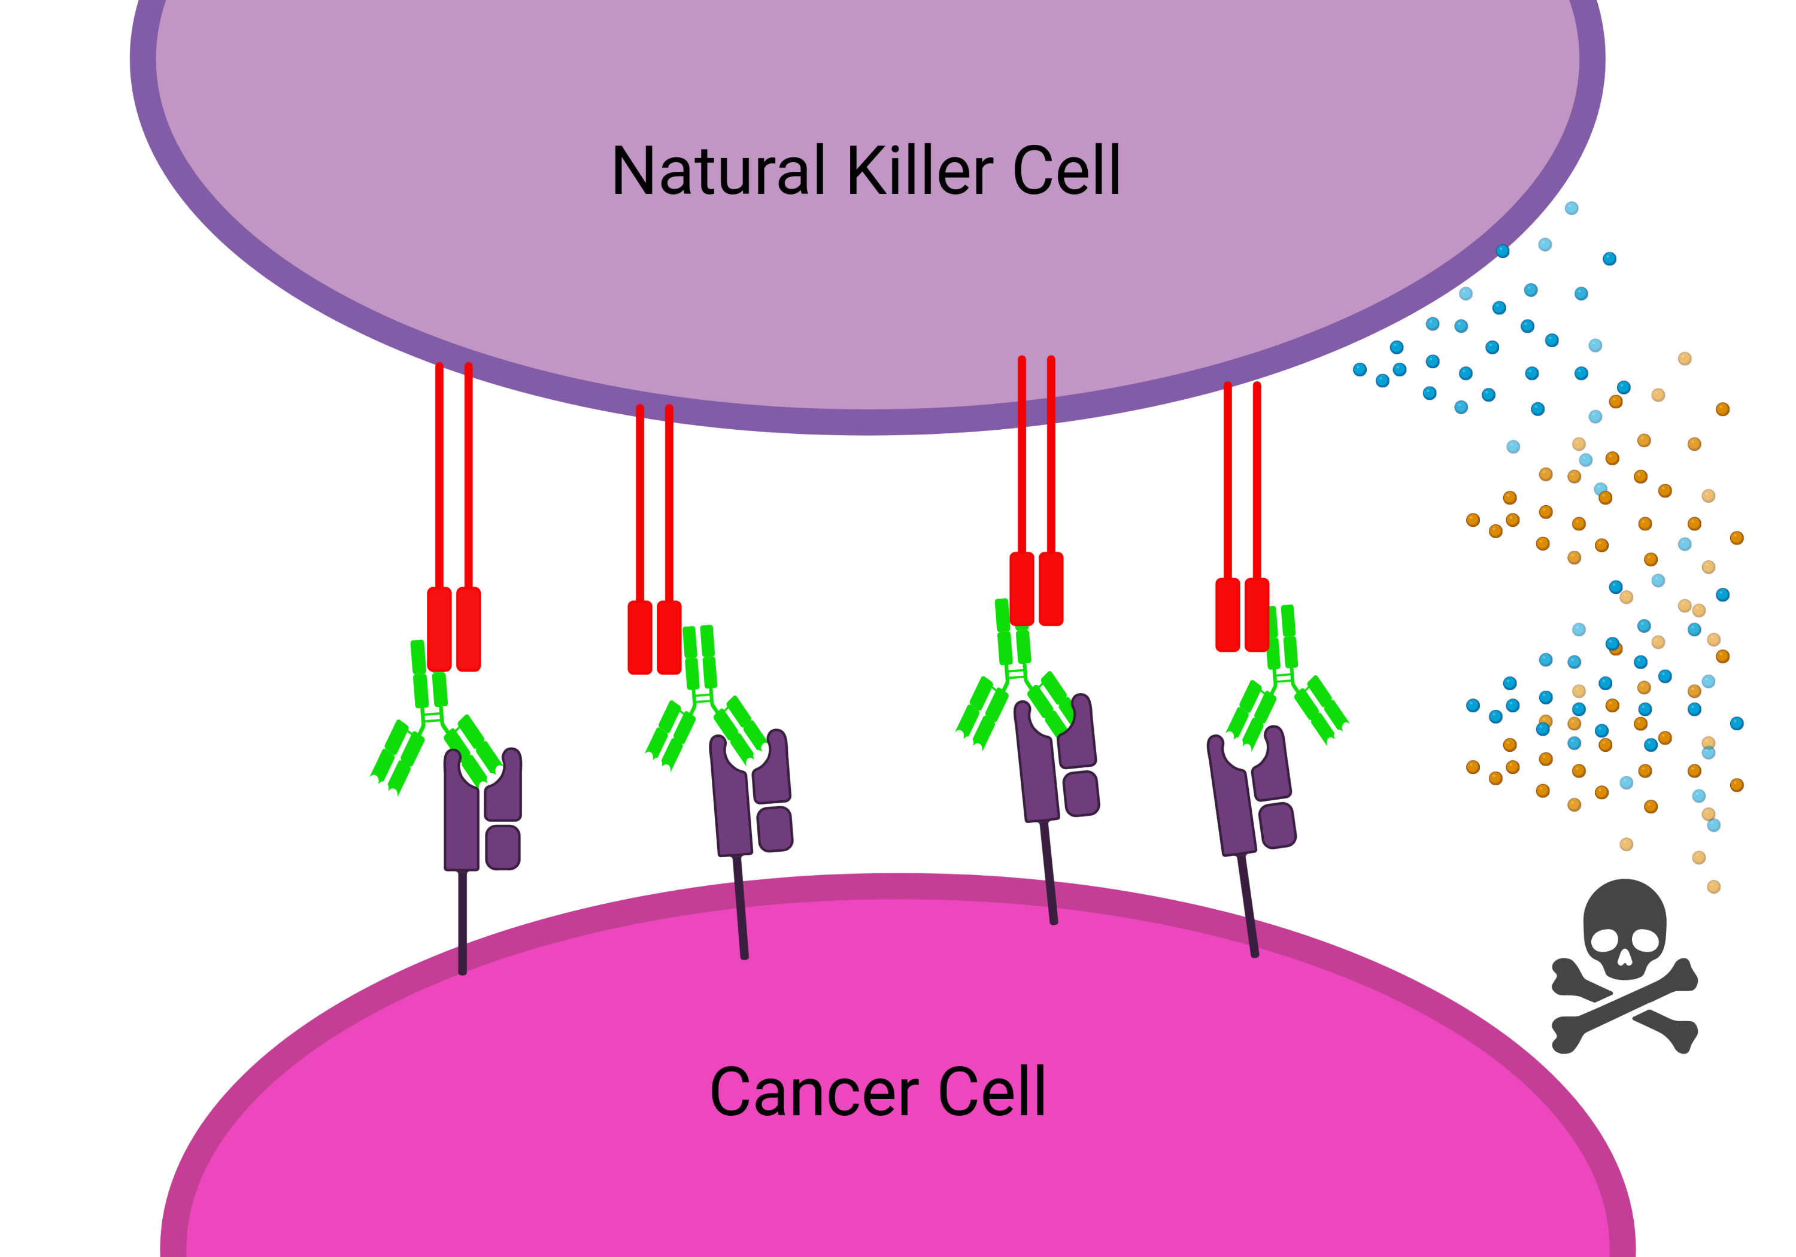
What is ADCC?
Mabs exert their effects through effector functions
Antibody-dependent cellular cytotoxicity guides the immune system to attack the tumour

Slide 5
Multiscale Processes affect ADCC
Microscale (receptor level dynamics)
ADCC
Macroscale (cell-cell interactions)

Slide 6
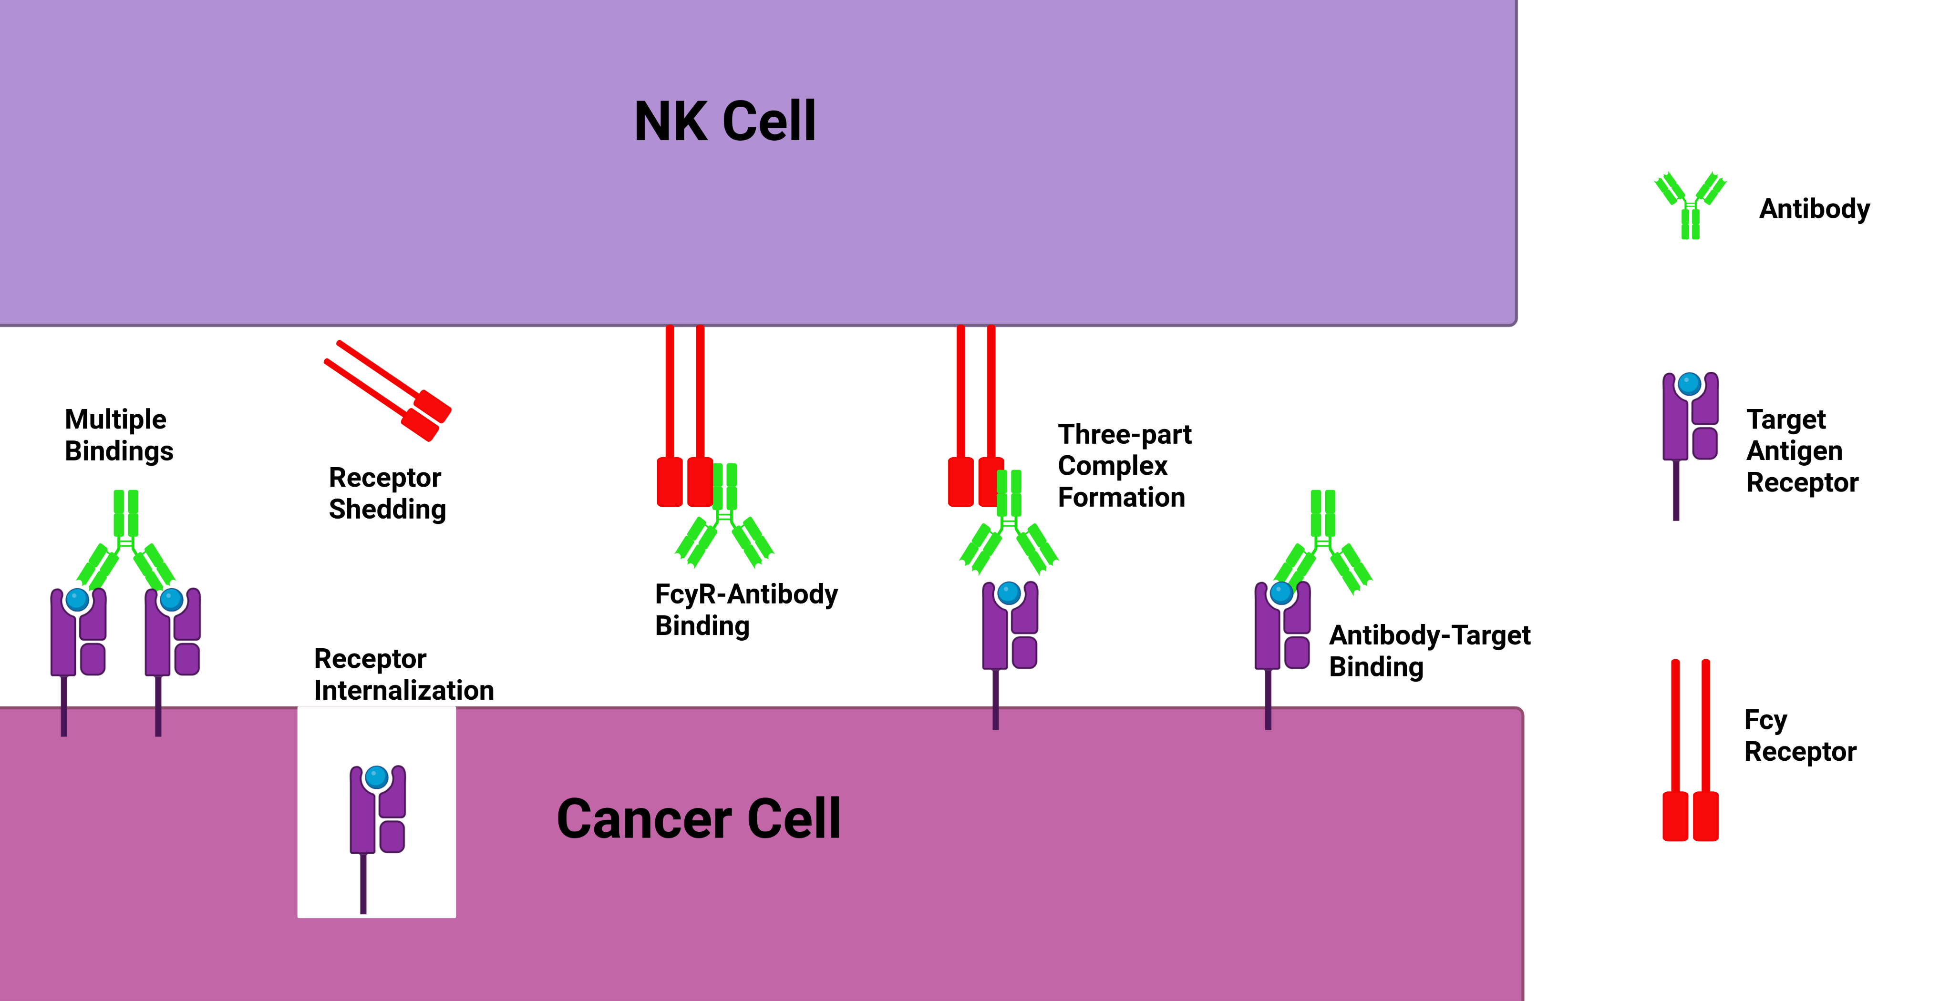
Microscale Dynamics

Slide 7

Why Do We Care?
What are the key mechanisms that affect ADCC?
How much can we optimize antibody properties and dose for ADCC?
How do you model biologics on the microscale?
Given microscale parameters can we predict a macroscale outcome such as ADCC potency?
Key Parameters:
On/off rates
Valency
Receptor number/density

Slide 8
Talk Outline
Single cell antibody binding model
How to model cross-linking?
Immune synapse model
Future work

Slide 9

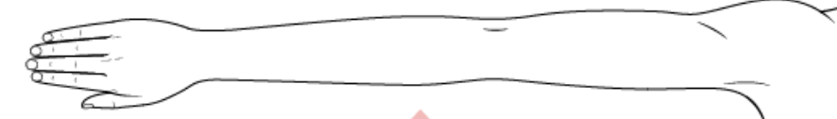
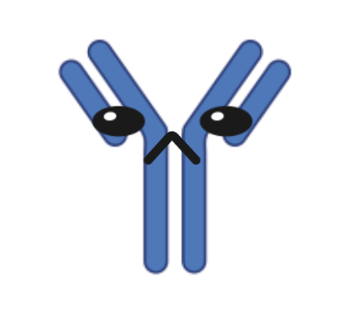

Affinity vs Avidity
Multiple bindings (avidity) results in stronger apparent overall binding strength (affinity)
VS

Slide 10
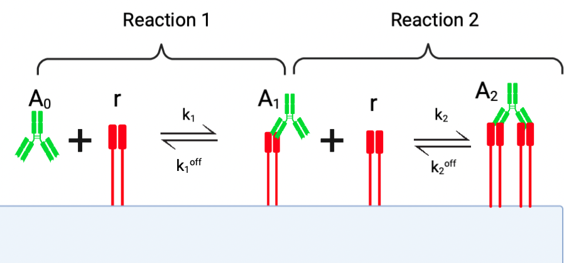

Slide 11
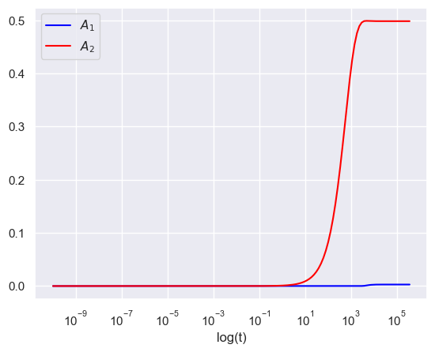
Model Dynamics

Slide 12
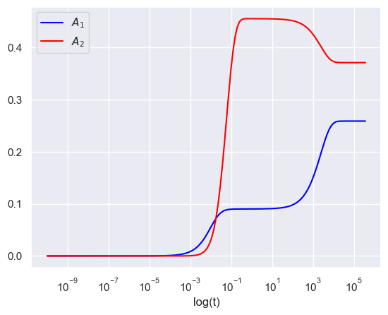
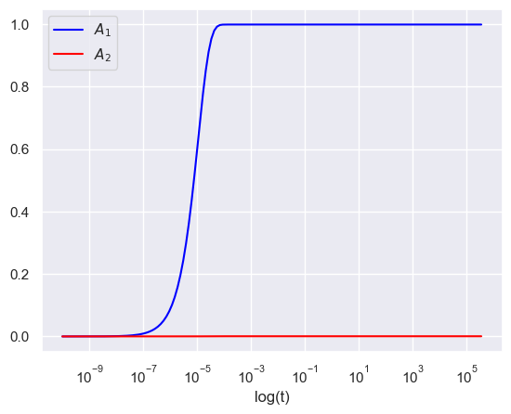

Slide 13
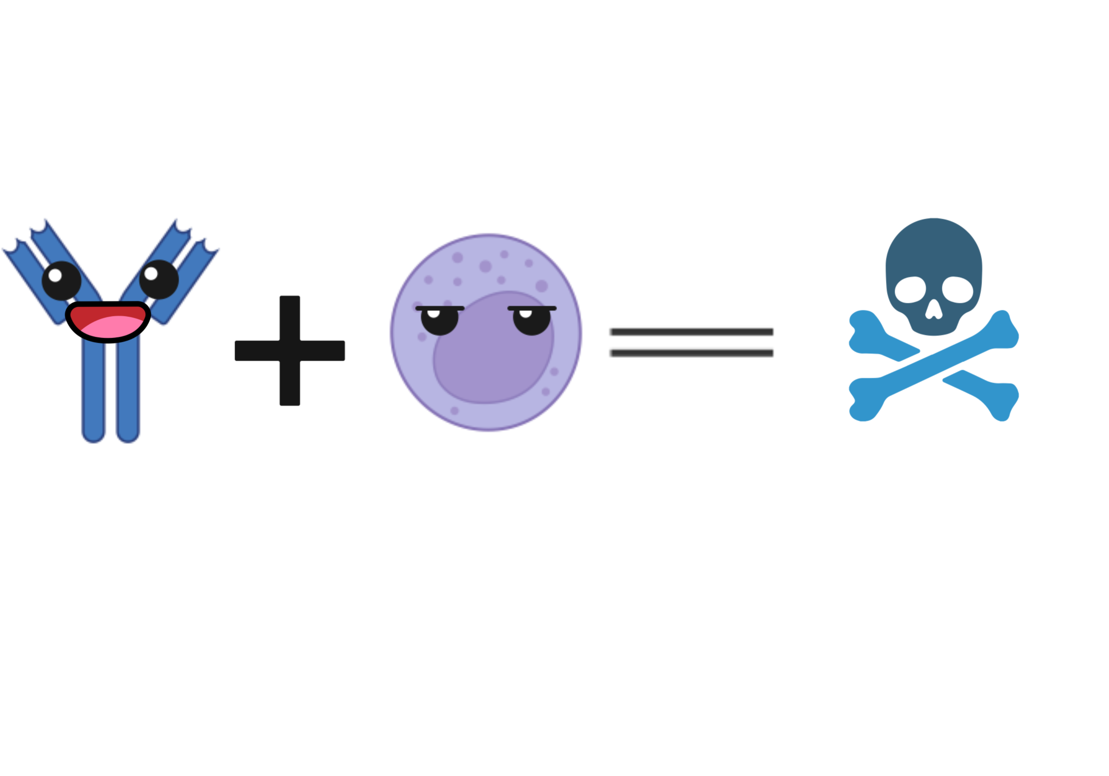

The Ratio of Antibody to Receptor Affects Binding States

Slide 14
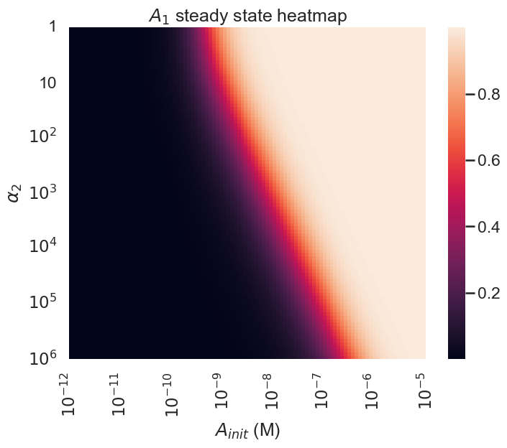
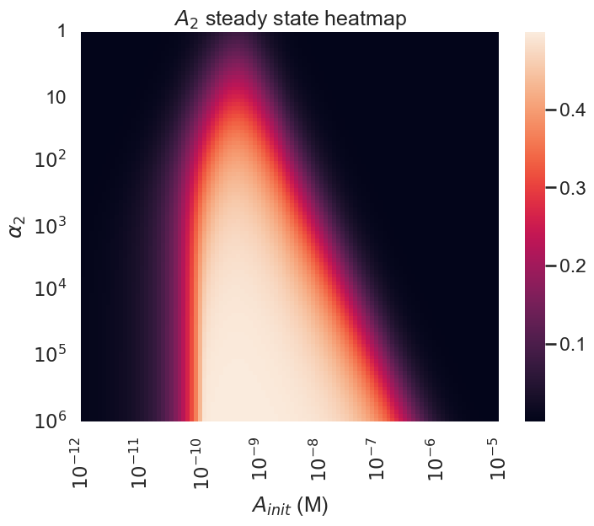
Steady States Show Different Binding Regimes

Slide 15
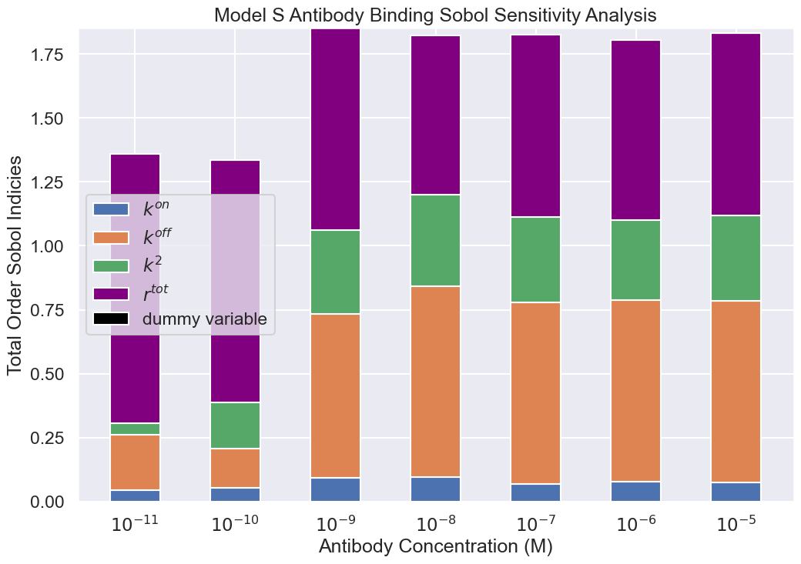
Sensitivity Analysis

Slide 16
Diffusion-limited Cross-Linking

Slide 17

Cross-linking via a Local Concentration

Slide 18
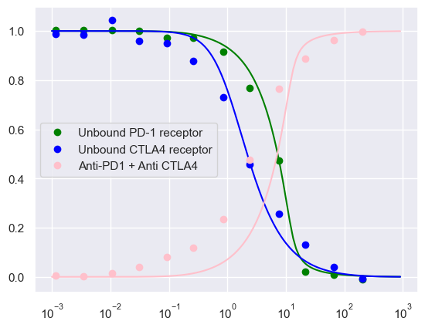
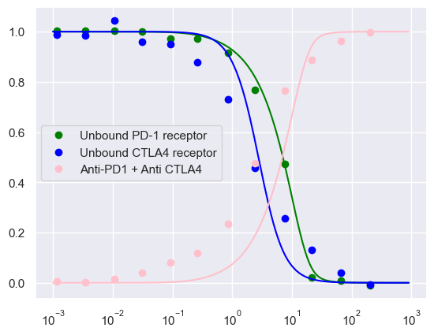
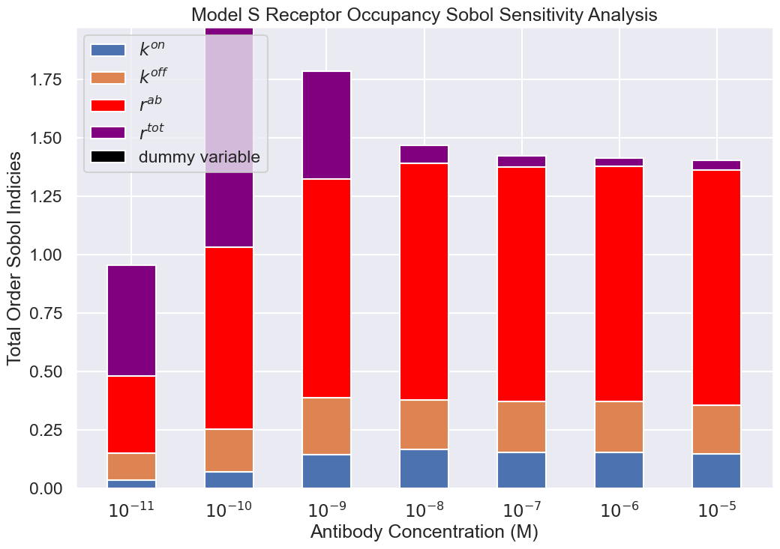
Ongoing work: Model Comparisons

Slide 19
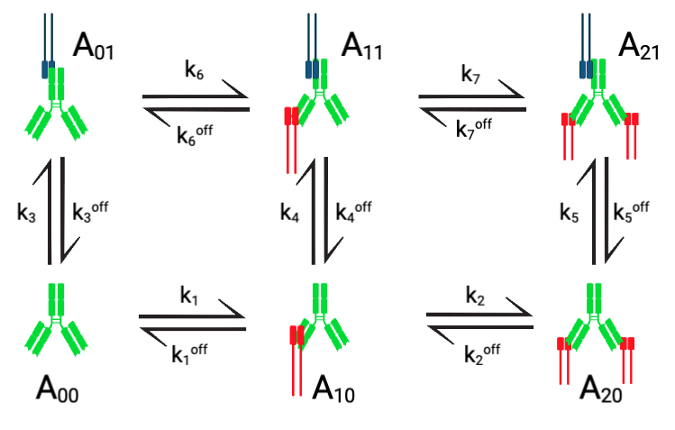
Synapse Model Schematic

Slide 20
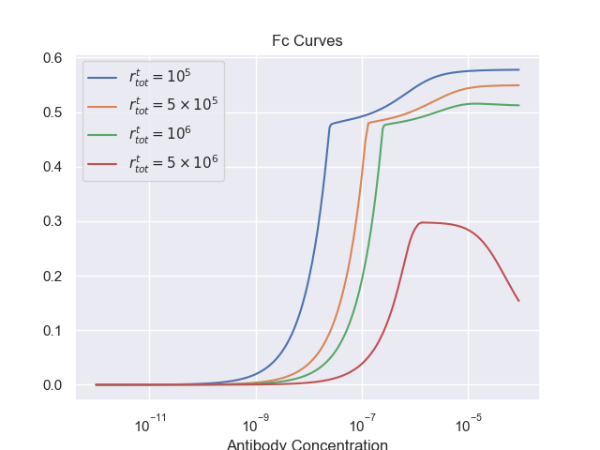
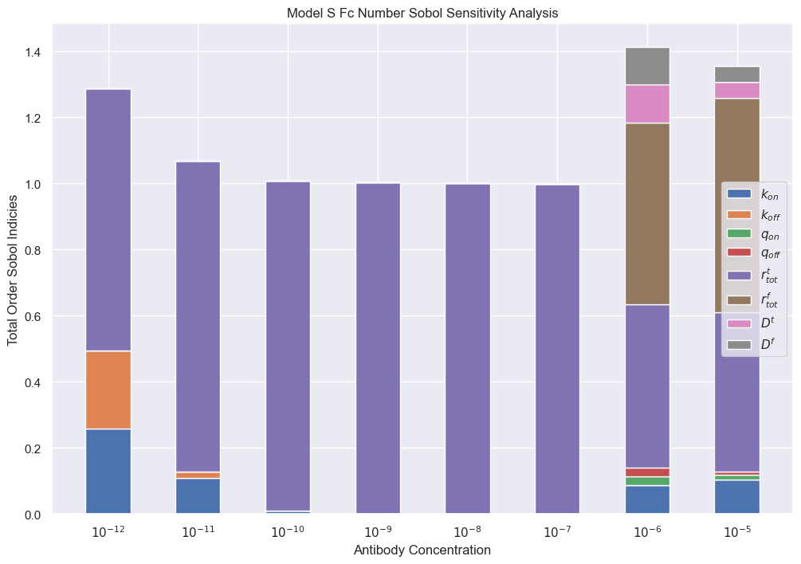
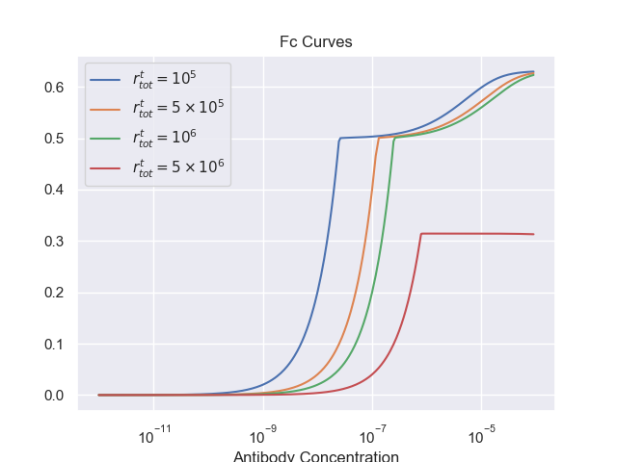
ADCC Potential

Slide 21
Future work
Asymptotic analysis
Distinguish between two cross-binding methodologies
Realistic parameter regimes for synapse model
Establish the existence or lack thereof of an optimum ADCC concentration
Best way to incorporate fc variable from synapse model into a multiscale model of ADCC?

Slide 22
Thank you for listening

